Slide 1
Factor Analysis

Slide 2
Factor Analysis
Data Reduction
Interrelationships among large no. of variables
Identify common underlying dimension
Search for Fundamental Constructs

Slide 3
Factor Analysis
Removes redundancy or duplication from a set of correlated variables
Represents correlated variables with a smaller set of “derived” variables.
Factors are formed that are relatively independent of one another.
Two types of “variables”:
–latent variables: factors
–observed variables

Slide 4
Factor Analysis
Uses Correlations
Normalize Data
Explains the total variation
Select Factors which Explain Maximum Variation
Methods of Rotation

Slide 5
Introduction
Identify attributes which are similar
Identify sets of statements that have highly correlated responses
Identify statements that measure some factor which is common to all of them
There can be more than one set. Identify underlying basic construct
Applied to continuous or scaled variables. Not categorical variables

Slide 6
Introduction
Uses Principle Component Analysis
Method for re-expressing multivariate data so that first few dimensions account for as much information as possible
Selects (components) factors, one at a time using procedures which “best fit” each factor to the data.
Each Subsequent factor is selected to explain residual variance
These factors uncorrelated to each other.

Slide 7
Nutrients and Food Items

Slide 8
Food Items sorted by Nutrients
Parsley
Kale
Broccoli
Cauliflower
Soybeans
Yam
Guinea Hen
Parsley
Kale
Broccoli
Cauliflower
Cabbage
Spinach
Soybeans
Yam
Guinea Hen
Bluefish
Mackerel
Chicken
Pork
Lamb
Parsley
Kale
Peas
Broccoli
Cauliflower
Cabbage
Spinach
Soybeans
Eggplant
Yam
Haddock
Guinea Hen
Bluefish
Mackerel
Chicken
Pork
Lamb
Vitamin C + Fiber - Fat
Vitamin C - Fat
Vitamin C

Slide 9
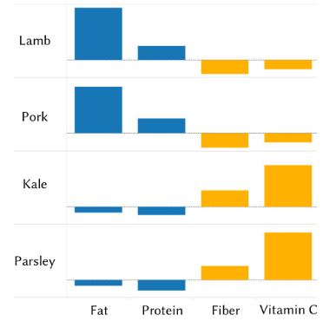
Comparison of nutrient levels in Different Food Items (Look for correlations)

Slide 10
Principal Components
 | PC 1 | PC 2 | PC 3 | PC 4
Fat | -0.45 | 0.66 | 0.58 | 0.18
Protein | -0.55 | 0.21 | -0.46 | -0.67
Fiber | 0.55 | 0.19 | 0.43 | -0.69
Vitamin-C | 0.44 | 0.7 | -0.52 | 0.22
PC 1 for a particular food item is
F1 = 0.55 (Fiber + 0.44 (Vit-C) – 0.45 (Fat) – 0.55(Protein)

Slide 11
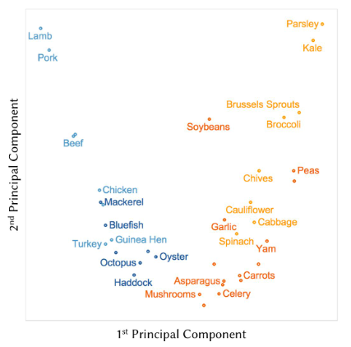
Two Principal Components
Non-leafy Veg have lower Vit-C
Sea food has Lower Fat Content

Slide 12
Exploratory Factor Analysis
Exploratory Factor Analysis
Known as Common Factor Model
Makes explicit assumptions about how each variable is measured
Observed variance of each measure is attributable to a small number of common factors
“Rotation” is useful to facilitate the interpretation of a factor

Slide 13
Factor Analysis – Example
Customers from 3 Banks
IOB, Vysya and Canara
Computerized Branches
369 Customers
131 Variables/Attributes

Slide 14
Factor Analysis – Example

Slide 15
Factors 1,2 and 3

Slide 16
Factor 4

Slide 17
Exploratory Factor Analysis
No prior notion about the factors
Lets every variable load on every factor
Use rotation to identify an “interpretable” solution
Factors are uncorrelated
Goal is to infer factor structure

Slide 18
Exploratory Factor Analysis
A case of 5 variables and 2 factors
X1=b11 F1+B12 F2+e1
X2=b21 F1+B22 F2+e2
X3=b31 F1+B32 F2+e3
X4=b41 F1+B42 F2+e4
X5=b51 F1+B52 F2+e5

Slide 19
Some Concepts
F is latent (i.e. unobserved, underlying) variable
X’s are observed (i.e. manifest) variables
e_{ji}s measurement error for X_{j}.
λ_{ji}s the “loading” for X_{j}.

Slide 20
Assumptions of Factor Analysis
Measurement error has constant variance and mean 0.
Var (e_{j}) = σ_{j}²; E(e_{j}) = 0
No association between the factor and measurement error
Cov(F,e_{j}) = 0
No association between errors:
Cov(e_{j},e_{k}) = 0
Given the factor, observed variables are independent of one another.
Cov ( X_{j},X_{k} | F ) = 0

Slide 21
Factor Analysis Model
The factors are uncorrelated with each other.
The common factors themselves can be expressed as linear combinations of the observed variables.
F_{i} = λ_{i1}X₁ + λ _{i2}X₂ + λ _{i3}X₃ + . . . + λ _{ik}X_{k}
where
F_{i} = estimate of i th factor
λ_{ij} = weight or factor score coefficient
k = number of variables

Slide 22
Data Reduction
Summarization of data with many (p) variables by a smaller set of (k) derived (synthetic, composite) variables.
“Residual” variation is information in A that is not captured in F
p
k
A
F
n
n

Slide 23
Principal Component Analysis (PCA)
Probably the most widely-used and well-known of the “standard” multivariate methods
Developed by Pearson (1901) and Hotelling (1933)
First applied in ecology by Goodall (1954) under the name “factor analysis” (“principal factor analysis” is a synonym of PCA).

Slide 24
PCA
Objective of PCA is to rigidly rotate the axes of this p-dimensional space to new positions (principal axes) that have the following properties:
Ordered such that principal axis 1 has the highest variance, axis 2 has the next highest variance, .... , and axis p has the lowest variance
Covariance among each pair of the principal axes is zero (the principal axes are uncorrelated).

Slide 25
PCA Vs. CFA
PCA
CFA
Total variance in the data is considered.
Full variance is brought into the factor matrix.
PCA is recommended when the primary concern is to determine the minimum number of factors that will account for maximum variance in the data
Use in subsequent multivariate analysis.
The factors are called principal components.
Estimated based only on the common variance.
Communalities are inserted in the diagonal of the correlation matrix.
Appropriate when the primary concern is to identify the underlying dimensions and the common variance is of interest.
This method is also known as principal axis factoring.

Slide 26
Some Definitions
Bartlett's test of sphericity. Bartlett's test of sphericity is a test statistic used to examine the hypothesis that the variables are uncorrelated in the population. In other words, the population correlation matrix is an identity matrix; each variable correlates perfectly with itself (r = 1) but has no correlation with the other variables (r = 0).
Correlation matrix. A correlation matrix is a lower triangle matrix showing the simple correlations, r, between all possible pairs of variables included in the analysis. The diagonal elements, which are all 1, are usually omitted.

Slide 27
Some Definitions
Communality. Communality is the amount of variance a variable shares with all the other variables being considered. This is also the proportion of variance explained by the common factors.
Eigenvalue. The eigenvalue represents the total variance explained by each factor.
Factor loadings. Factor loadings are simple correlations between the variables and the factors.
Factor loading plot. A factor loading plot is a plot of the original variables using the factor loadings as coordinates.
Factor matrix. A factor matrix contains the factor loadings of all the variables on all the factors extracted.

Slide 28
Some Definitions
Factor scores. Factor scores are composite scores estimated for each respondent on the derived factors.
Kaiser-Meyer-Olkin (KMO) measure of sampling adequacy. The Kaiser-Meyer-Olkin (KMO) measure of sampling adequacy is an index used to examine the appropriateness of factor analysis. High values (between 0.5 and 1.0) indicate factor analysis is appropriate. Values below 0.5 imply that factor analysis may not be appropriate.
Residuals are the differences between the observed correlations, as given in the input correlation matrix, and the reproduced correlations, as estimated from the factor matrix.

Slide 29
Rotation
The common factor model has infinite number of solutions
(Not so with PCA!)
Then, Why not choose the one which is better understandable/ interpretable?
Use rotation to achieve this

Slide 30
Unrotated

Slide 31
Varimax Rotation

Slide 32
After Rotation

Slide 33
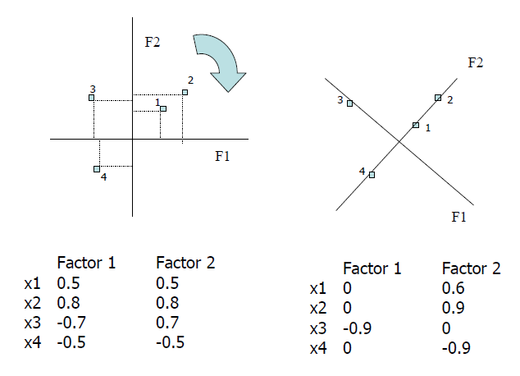
Rotation - Example

Slide 34
PROMAX Rotation
Factor 1
Factor 2

Slide 35
Rotation
Varimax Method. An orthogonal rotation method that minimizes the number of variables that have high loadings on each factor. This method simplifies the interpretation of the factors.
Quartimax Method. A rotation method that minimizes the number of factors needed to explain each variable. This method simplifies the interpretation of the observed variables.

Slide 36
Rotation
Equamax Method. A rotation method that is a combination of the varimax method, which simplifies the factors, and the quartimax method which simplifies the variables.
The number of variables that load highly on a factor and the number of factors needed to explain a variable are minimized.

Slide 37
Rotation
Direct Oblimin Method. A method for oblique (nonorthogonal) rotation.
Promax Rotation. An oblique rotation, which allows factors to be correlated.
This rotation can be calculated more quickly than a direct oblimin rotation, so it is useful for large datasets.

Slide 38
How to decide on k, Number of Factors?
The number of uncorrelated constructs that are jointly measured by the X’s.
Only useful if number of factors is less than number of X’s
Interpretability

Slide 39
How to decide on k?
Consider Eigen values from a principal components analysis
Two interpretations:
Eigenvalue ≅ equivalent number of variables which the factor represents
Eigen value ≅ amount of variance in the data described by the factor.
Rules to go by:
number of eigenvalues> 1
Scree plot
% variance explained

Slide 40
Scree Plot
3.0
2.5
2.0
Eigenvalue
1.5
1.0
0.5
0.0
1
2
3
4
5
6
Component Number

Slide 41
Questions
Clarifications?

